Slide 1

Ocular Injuries
Dr. Loay abdulmutalib almusawi
FRCS(Glasgow), fibms, fico

Slide 2
Objectives
Types of ocular injuries.
Modes of presentation.
Timely management of each type.
Expected complications.
Prevention of ocular trauma.

Slide 3

Overview
The term ocular injuries is often used to encompass both trauma to the globe and peri-ocular tissues including the orbit.
Exclude associated injuries.
You are dealing with a patient not just an eye.

Slide 4
Terminology
Closed injury is commonly due to blunt trauma. The corneoscleral wall of the globe is intact.
Open injury involves a full-thickness wound of the corneoscleral envelope.
Rupture is a full-thickness wound caused by blunt trauma. The globe gives way at its weakest point, which may not be at the site of impact.

Slide 5
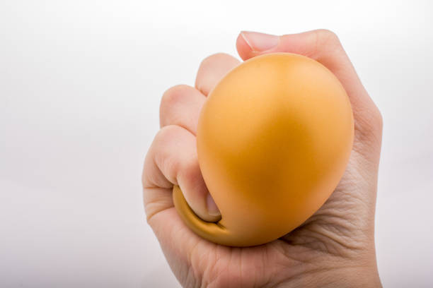

Slide 6
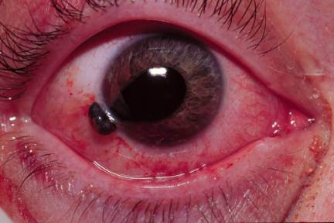

Slide 7
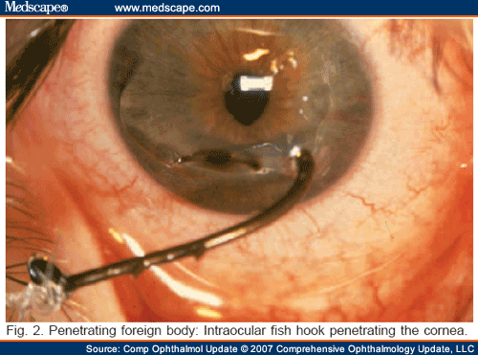
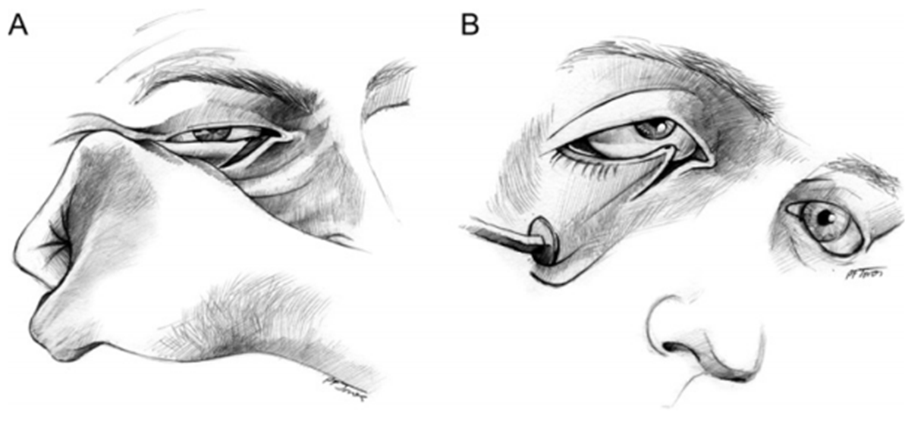
Terminology
Laceration is a full-thickness defect in the eye wall produced by a tearing injury, usually as the result of a direct impact.
Notes:
Lamellar laceration is a full-thickness laceration.

Slide 8
Terminology
Incised injury is caused by a sharp object such as glass or a knife.
What is the difference between penetrating and perforating injuries?
Notes:
Lamellar laceration is a full-thickness laceration.

Slide 9
Trauma to the globe
Blunt
Penetrating

Slide 10
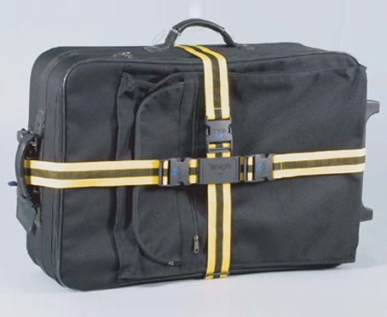

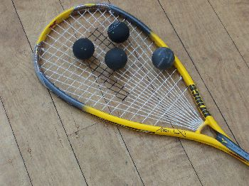
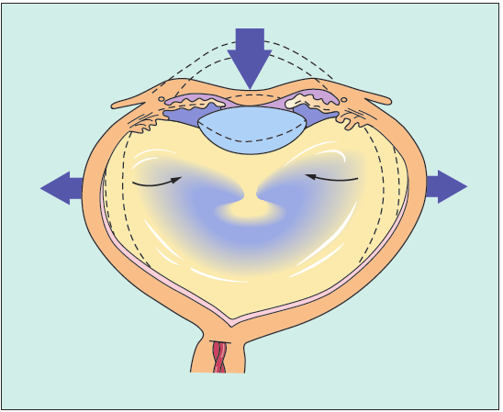
The Scope of Blunt Trauma
What are the most common causes ?
Mechanism of ocular tissue damage:
Apart from obvious ocular damage, blunt trauma commonly results in more obscure long-term effects; the prognosis is therefore necessarily guarded.

Slide 11
The Scope of Blunt Trauma
Cornea:
  Abrasion.
  Acute corneal edema.
  Breaks in the Descemet membrane.

Slide 12
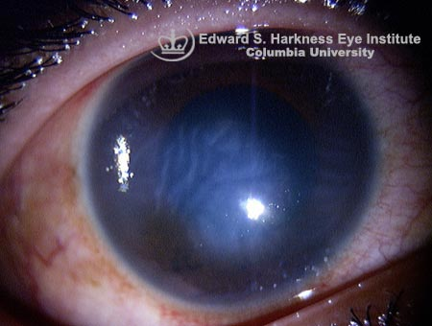

Slide 13
The Scope of Blunt Trauma
Cornea:
  Abrasion.
  Acute corneal edema.
  Breaks in the Descemet membrane.
Anterior Chamber:
  Hyphema

Slide 14
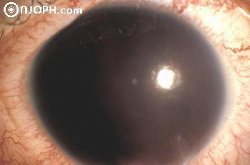
Appearance of hyphema.
Source of bleeding.
Treat with aqueous suppressnats, topical steroid and cycloplegics.
Monitor for complications:
  Corneal blood staining.
  Raised intra-ocular pressure
  Optic neuropathy

Slide 15
The Scope of Blunt Trauma
Anterior uvea:
  Pupil → Traumatic mydriasis & radial sphincter tear.
  Iris → Iridodialysis (separation of the iris from its root)
      Traumatic aniridia.
  Ciliary Body → cliary shock, cyclodialysis cleft.

Slide 16
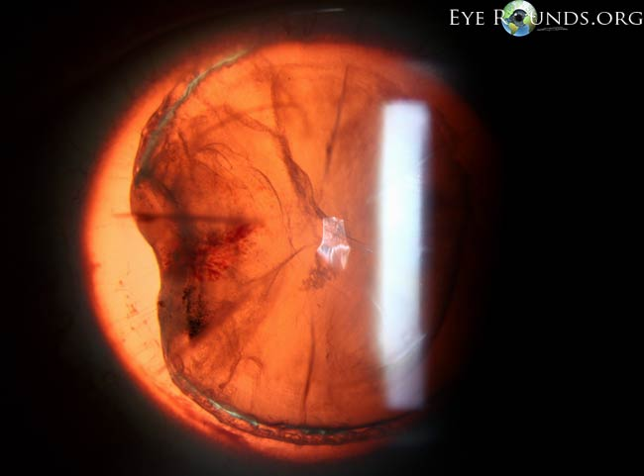

Slide 17
The Scope of Blunt Trauma
Lens:
  Cataract (types, progression).
  Subluxation.
  Dislocation (usually predisposed by pseudoexfoliation).

Slide 19
The Scope of Blunt Trauma
Retina & vitreous:
  Vitreous Hemorrhage
  Commotio Retinae: a concussion injury of the retina resulting in cloudy swelling. (cherry-red spot)
    Mild cases → good prognosis (resolve in 6 months)
    Severe → intraretinal hemorrhage, progressive pigmentary degeneration & macular hole formation.

Slide 21
The Scope of Blunt Trauma
Retina & vitreous:
  Choroidal Rupture.
    - direct or indirect
    - poor prognosis if the fovea is involved
    - associated subretinal or vitreous hemorrhage
    - late complication → choroidal neovascularization

Slide 23
The Scope of Blunt Trauma
Retina & vitreous:
  Retinal breaks and detachment
    Retinal dialysis: avulsion of the vitreous base from its attachment
    Equatorial breaks: at the point of impact
    Macular hole: develops either at the time of trauma or following resolution of commotio retina.

Slide 24

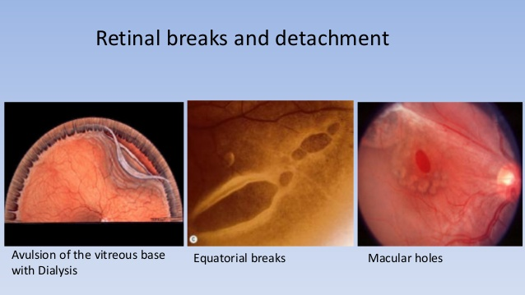

Slide 25
The Scope of Blunt Trauma
Optic Nerve:
  1-Indirect traumatic optic neuropathy
    (contusion, deformation, tethering, secondary vasospasm)
  2-Direct (e.g. compression by bony fragments).
  3-Optic nerve avulsion
  Sudden unexplained visual loss
  Associated head trauma may be deceptively minor
  50% very poor vision

Slide 26
The Scope of Blunt Trauma
Optic Nerve:
  RAPD
  Fundus examination is initially normal
  CT/MRI → exclude compression by hematoma/bony frag.
  50% → spontaneous improvement
  Intravenous steroids (first 8 hours)
  Surgery for compression

Slide 27
The Scope of Blunt Trauma
Globe rupture:
  Severe blunt trauma.
  Prognosis ?
  Site (anterior, posterior or at surgical incisions).
  Signs of occult rupture:
    Asymmetrical AC depth
    Asymmetrical Intra-ocular pressure

Slide 28
The Scope of Blunt Trauma
Globe rupture:
  Exclude intra-ocular foreign body.
  CT scan and MRI
  Gentle B scan ultrasonography
  MRI is contraindicated if ferrous FB is suspected.

Slide 29
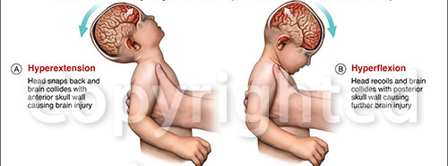
The Scope of Blunt Trauma
Shaken Baby Syndrome:
  < 2 years of age (25% mortality rate)
  Irritability, lethargy, vomiting.
  Soft tissue bruises, SAH, survivors suffer neur. Handicap
  Ocular Features →
    multiple bilateral retinal hemorrhage
    Visual loss due to cerebral damage
    subconj hemorrhage and peri-ocular bruising.

Slide 31
Penetrating Trauma

Slide 32
The Scope of Penetrating Trauma
  - 3 times more common in male (50% → 15-34 years).
  - Assault, occupational and domestic accidents.
  - Size, speed and composition of object.
  - Endophthalmitis / Panophthalmitis → loss of the eye.
  - Always ascertain tetanus immunization status.
  - An eye with open injury should be covered with a protective shield upon the diagnosis.

Slide 33
The Scope of Penetrating Trauma
Cornea:
  Peaked pupil
  Shallow Anterior chamber
  May be only full-thickness wound
  Small shelving wounds with a formed AC → bandage CL
  Medium-sized → should be sutured without delay (10/0)
  With iris prolapse → excision of the necrotic portion
  With lens damage → wound repair then lens extraction
Notes:
The corneoscleral junction should be sutured with 9-0 nylon

Slide 34
The Scope of Penetrating Trauma
Sclera:
  Anterior:
    Better prognosis.
    Vitreous incarceration → fibrous proliferation → tractional retinal detachment.
    Suture with 8/0 nylon or 7/0 absorbable.
  Posterior:
    Frequently associated with retinal damage.
    Priority is to restore globe integrity.
Notes:
The corneoscleral junction should be sutured with 9-0 nylon

Slide 35
Enucleation
Primary
  Extremely severe injuries with no prospect of retention of any vision.
Secondary
  Blind, uncomfortable, unsightly eye.
  Ideally within 10 days
  It allows time for emotional adaptation

Slide 36
Chemical Injuries
Range in severity from trivial to potentially blinding.
Majority are accidental. (2/3 at work)
Alkali burns are twice as common as acid burns.
Its severity is related to property of the chemical, contact surface area & duration of exposure.
Alkalis are more damaging.

Slide 37
Management of Chemical Injuries
Emergency Treatment:
  Copious irrigation for 15-30 min or until the PH is neutralized, tap water can be used until sterile solution is available.
  Double eversion of the lid.
  Debridement of necrotic areas.
  Admit to the hospital (severe burn)
Notes:
A chemical burn is the only type of eye injury the requires emergency treatment prior to formal clinical assessment.

Slide 38
Management of Chemical Injuries
Subsequent Medical Treatment:
  Examine for limbal ischemia and corneal clarity (grading), IOP, extent of epithelial loss & lens status.
  In severe burns, the aim is to reduce inflammation, promote re-epithelialization & prevent corneal ulceration.
  Steroids (only during first 7-10 days), then topical NSAIDS.
  Cycloplegics
  Topical Antibiotics
  Topical ascorbic acid / citric acid
  Systemic tetracycline

Slide 39
Management of Chemical Injuries
Surgical Treatment:
  Early:
    Restore limbal vascularity → tenon capsule advancement
    Restore limbal stem cell → LSC transplantation (auto/allo)
    Reestablish the fornices → amniotic membrane transplant
    Restore globe integrity → tissue glue or keratoplasty
  Late:
    Division of conjunctival bands & symblephara
    Correction of lid deformities (entropion)
    Keratoplasty / keratoprosthesis for scarring

Slide 40
Prevention of Ocular trauma
Recognition and survey of risk factors.
  Certain occupations, contact sport, only eye.
Protective eye wear for those at risk.
Correction were possible of visual impairment particularly if unilateral.
Implementation of educational programs to increase public awareness regarding prevention of ocular trauma.

Slide 41
To Sum-Up
Ocular trauma can be blunt or penetrating.
Blunt trauma can result in both open & closed injuries
Any ocular structure might be affected, the effect may not be present initially.
The priority in open injuries is to restore globe integrity & were possible anatomy.
Exclude any possible associated injury

Slide 42


